Slide 1
Generative Models

Slide 2
Mathematical Thinking of VAE
Two Perspectives:
1. Probabilistic Generative Model: input sample (xi) is associated with latent variable (zi), and then VAE describes a joint distribution over xi and zi.
2. Autoencoder: from input sample (xi) , zi is randomly generated

Slide 3
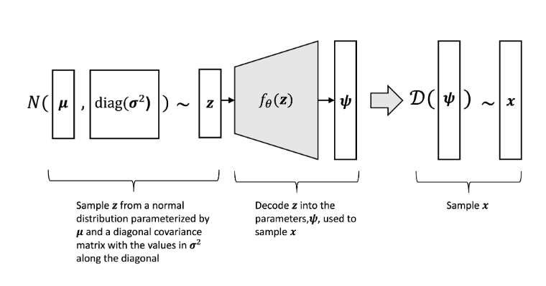
Probabilistic Model

Slide 4
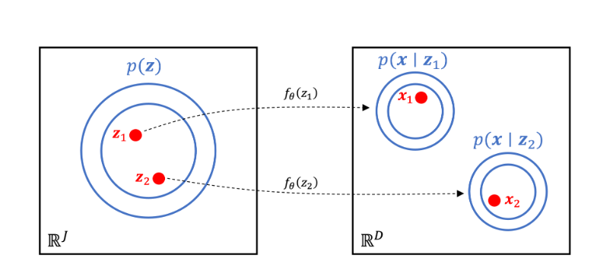
Probabilistic Model

Slide 5
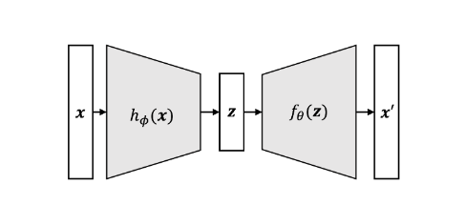

Slide 6

Since z is dependent on x, we need to find two things:
1. Posterior distribution of z, given x as:
2. Likelihood estimates of theta.

Slide 7

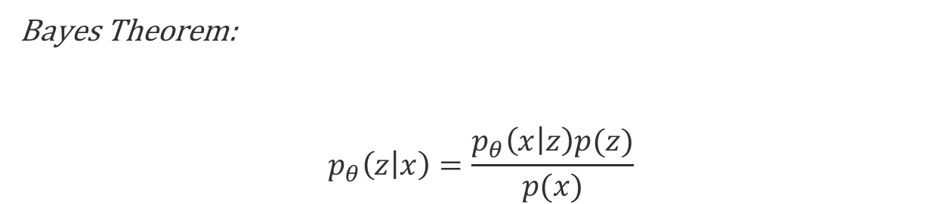
Solving posterior distribution problem
Bayes Theorem:
$$p_{θ}\left(z | x\right)=\frac{p_{θ}\left(x | z\right)p(z)}{p(x)}$$
Denominator is main culprit. It is intractable. So what’s the solution?

Slide 8
Solution
Variational Inference

Slide 9
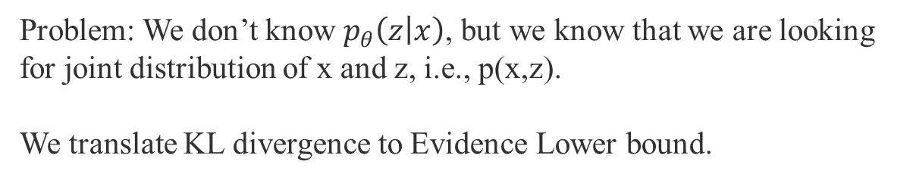
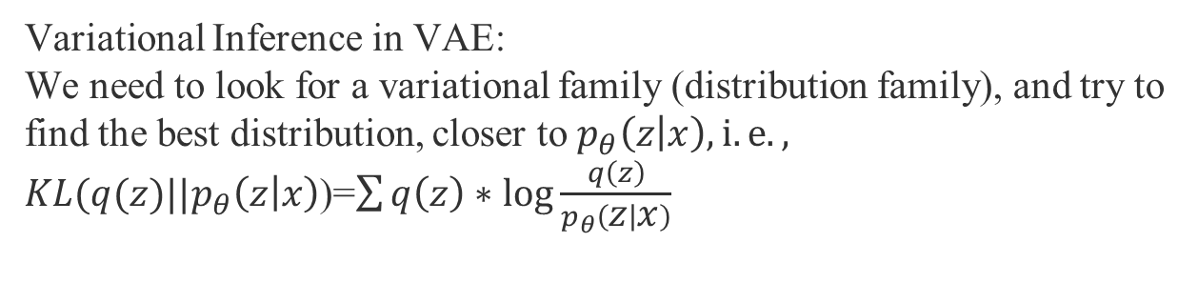
Variational Inference in VAE:
We need to look for a variational family (distribution family), and try to find the best distribution, closer to $p_{θ}\left(z | x\right), i.e.,$
$KL(q(z)||p_{θ}\left(z | x\right)$)=$\sum{q\left(z\right)∗\log{\frac{q\left(z\right)}{p_{θ}\left(z | x\right)}}}$
Problem: We don’t know $p_{θ}\left(z | x\right)$, but we know that we are looking for joint distribution of x and z, i.e., p(x,z).
We translate KL divergence to Evidence Lower bound.

Slide 10


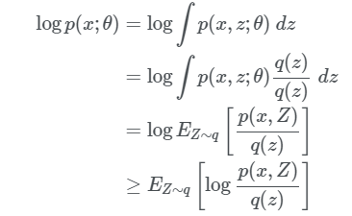

Evidence Lower Bound (ELBO)
Evidence/Log likelihood
Jensen Inequality

Slide 11
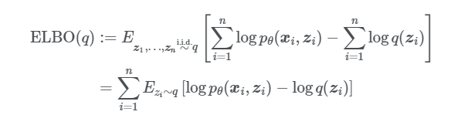
ELBO

Slide 12

Objective
The problem is we can find the posterior distribution with this method, but what about likelihood estimates?

Slide 13

Solution
We can do both the things simultaneously, i.e., finding the best distribution of q from Q, and likelihood estimates as follows:

Slide 14


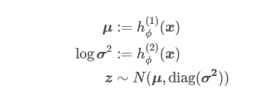
Real Stuff
Let’s start the process
Variational family:

Slide 15
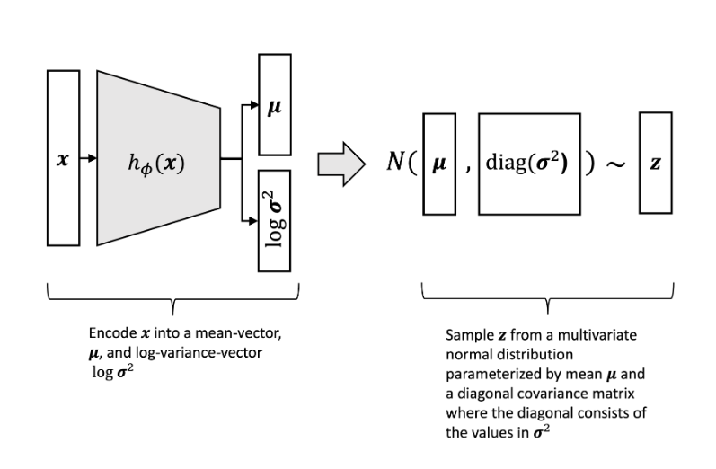

Slide 16
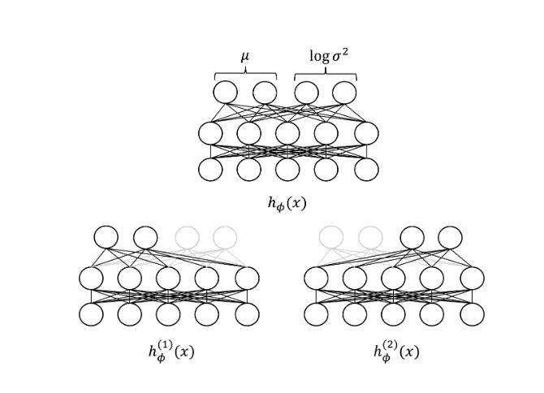

Slide 17
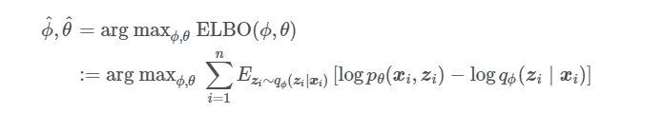
Maximizing ELBO
When we use common set of parameters, we call it as amortized variational inference.

Slide 18
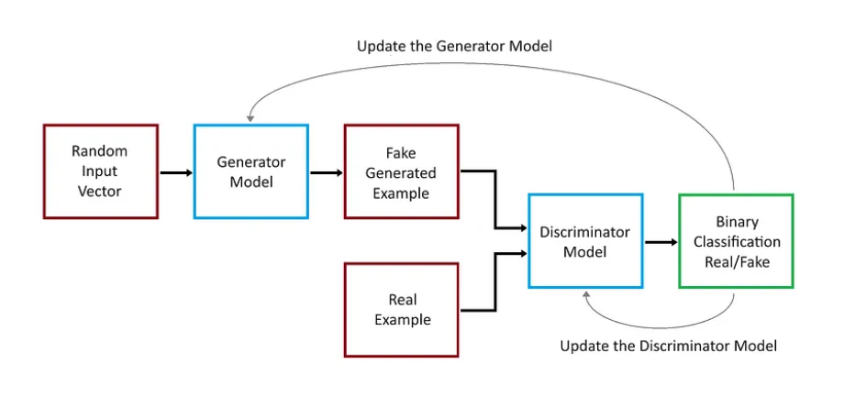
Generative Adversarial Networks

Slide 19
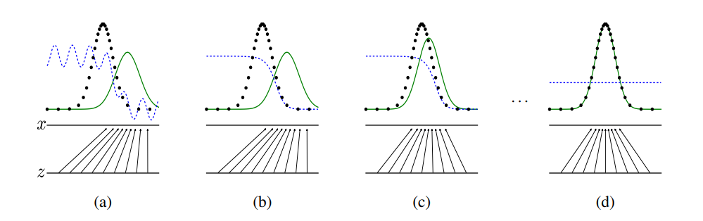
Min max game

Slide 20
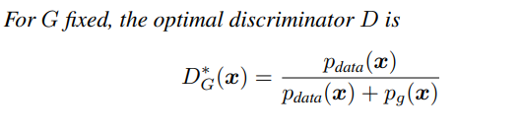
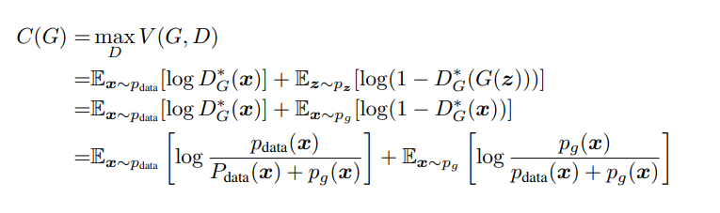
Optimality of Discriminator
The global minimum of the virtual training criterion C(G) is achieved if and only if pg = pdata. At that point, C(G) achieves the value − log 4.

Slide 21
Thank You

